Slide 1
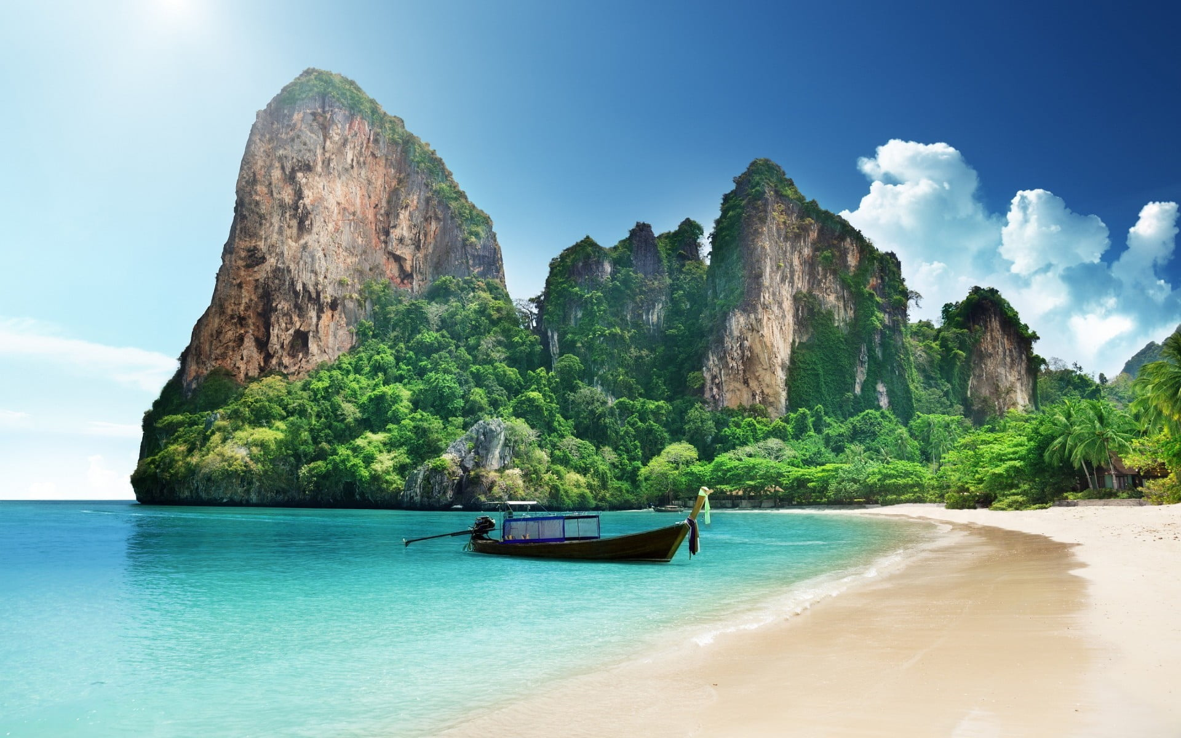
Cholo
Ghuri
Your trusted travel partner

Slide 2


Ou
Our team
MAHEDI HASAN
ADNANUL ISLAM
ASADUZZAMAN SHUVO
ID:011221119
011221096
Ela

Slide 3

Topics
2 | Introductin
3 | Background
4 | Aim and Objective
5 | Analysis
6 | features
7 | Flow chart
8 | Task management
9 | Refarances
10 | Conclusion

Slide 4

Introduction
1.What is Cholo Ghuri?
2.Why we call it travel partner??
3.Why you need it??

Slide 5
Background
Cost of hotels
Why we cant go on a tour??
lack of group mambers
can’t get permission from home
Unknown places
Afraid to get scammed
Not getting bus tickets

Slide 6

Our Aims
Finding your perfect travel partner
Saving your tour cost
Organizing safe tours
Suggesting best places for you
Making good memories
Back to Agenda

Slide 7
Analysis:
 | Bookmytrip | Airbnb | trip advisor | Chologhuri
Login | Yes | Yes | Yes | Yes
Review | Yes | yes | yes | yes
Connecting with others | No | NO | No | Yes
Fare bidding | No | No | No | Yes
Chatting with admin and host | No | No | No | Yes
Creating own tour | yes | No | Yes | Yes

Slide 8
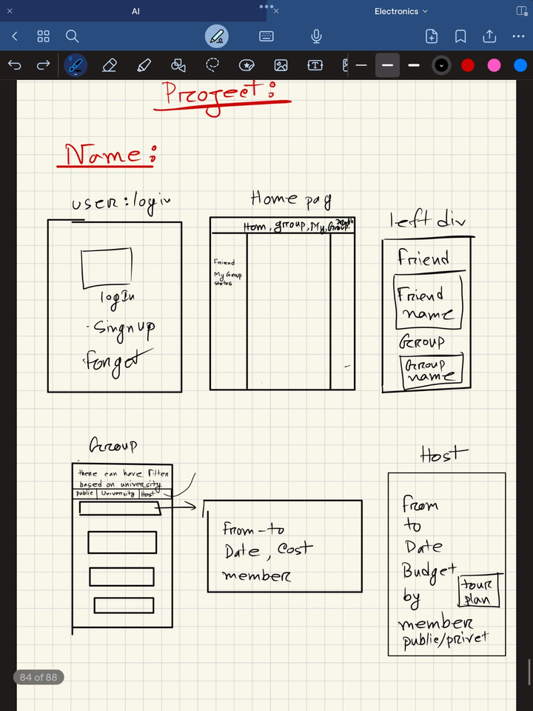
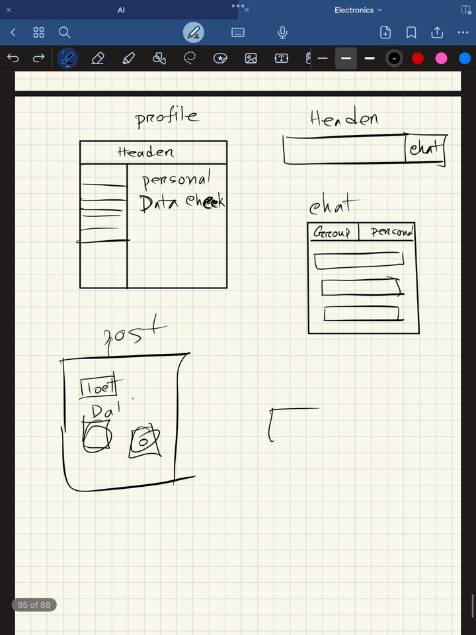
Feature List
Filtering desired tour
Secure login email
verify and recovering
via mail
Connecting with
desired host
Review of people
and place
Uploading memories
Trusted admin panal
Updating via group
Chatting With other

Slide 9
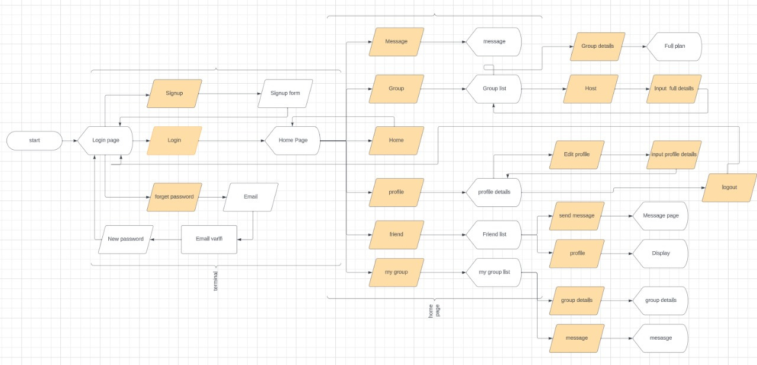
Flowchart:

Slide 10
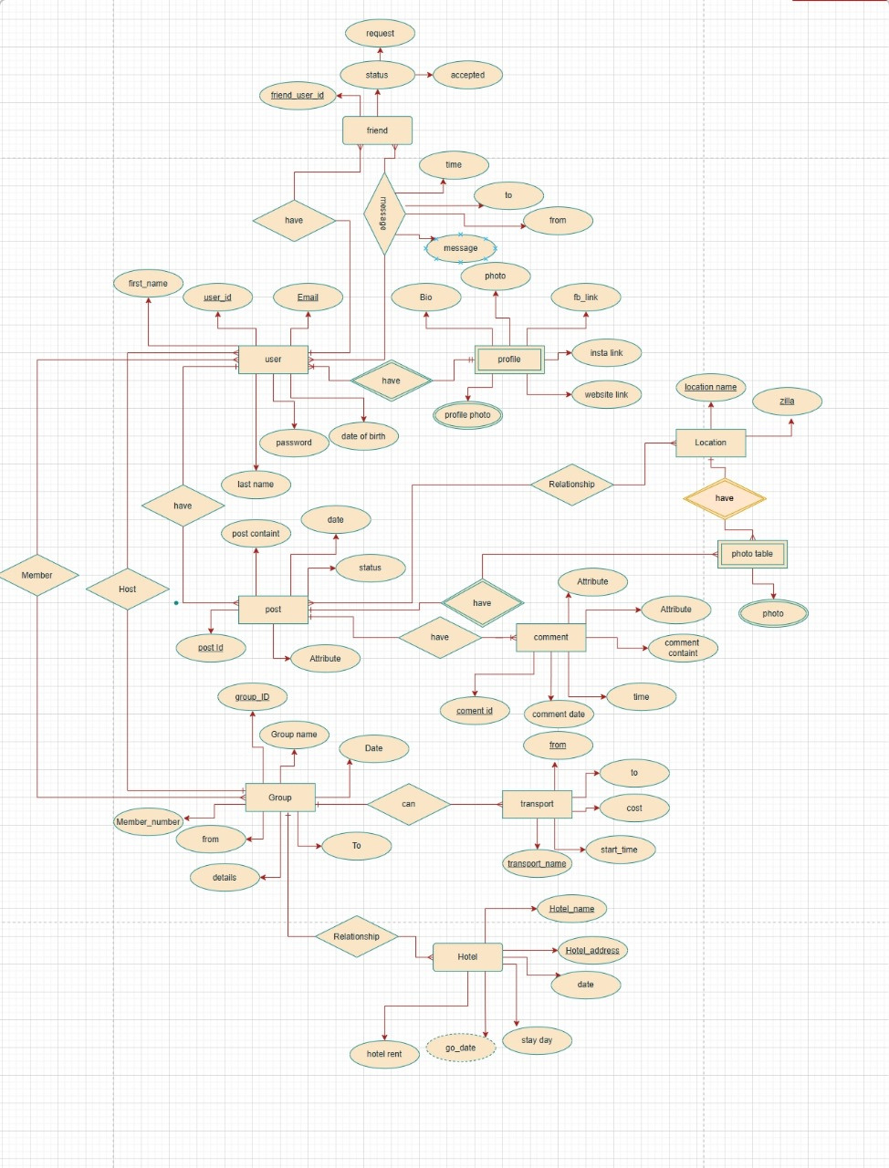

ER diagram:
ENTITIES:
Friend
User
Profile
Post
Location
Photo table
Group
Comment
Hotel

Slide 11
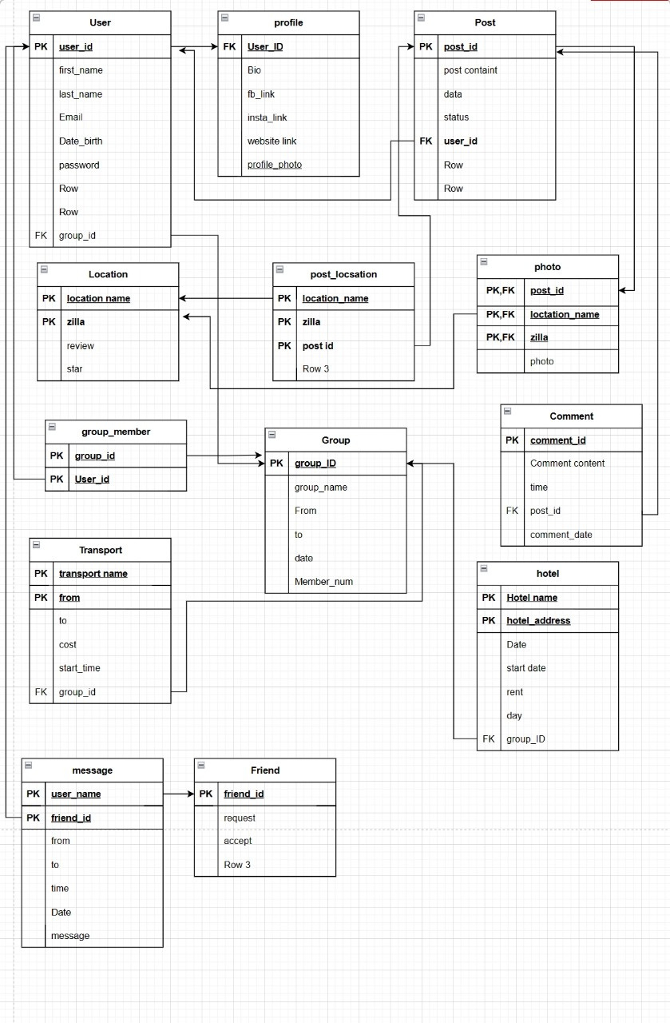
Schema:

Slide 12

Work distribution
Task distribution
Asaduzzaman:
Adnan
1.Login
1.Profile
2.Home
2.Review
3.Admin
3.Post
Mahedi
1.Group
2.Filter
Chatting, bidding and messeging
will be created by both of ours
contribution
3.Searching

Slide 13
Conclusion

Slide 14
References
1 | Report from forbs https://www.forbes.com/sites/ceciliarodriguez/2023/07/17/airbnb-related-scams-surge-beware-of-too-good-to-be-true-offers-experts-advise/?sh=67129d583bda
2 | bookmytrip.com
3 | arbnb.com
4 | makemytrip.com

Slide 15
